Slide 1
EMPLOYEE ATTENDANCE AND PRODUCTIVITY ANALYSIS

Slide 2
Agenda
1
Executive Overview & Problem Statement
2
Project Scope & Deliverables
3
Data Architecture & Semantic Model
4
Dashboard Walkthrough & Key Insights

Slide 3
Problem Statement
A mid-sized IT services organization with multiple delivery teams is experiencing inconsistencies in employee attendance and productivity across departments. While some teams consistently meet productivity targets, others struggle due to frequent absences, late check-ins, and uneven workload distribution.
Although the organization uses an HRMS system to track attendance and performance data, the management team finds it difficult to derive actionable insights from raw reports and spreadsheets. There is limited visibility into attendance trends, department-wise performance, and the relationship between attendance behaviour and productivity.
Fragmented Visibility
The Hybrid Blind Spot
Undetected Bottlenecks
Reactive Management
Disconnect between hours logged and actual business value delivered.
Current reporting relies purely on physical presence, making it impossible to measure true employee efficiency.
No standard framework exists to compare the output of Remote versus On-Site teams.
Without unified productivity data, leadership's return-to-office or remote policy decisions remain entirely speculative.
Critical issues, like an absenteeism rate spiking over 25%, are currently hidden within company-wide averages.
This lack of granularity prevents department heads from intervening before project delivery is impacted.
Zero predictive visibility into creeping overtime and chronic lateness trends.
Resource planning is forced to be reactive, leaving the organization exposed to project delays and high employee burnout.

Slide 4
Project Scope & Deliverables
Business Deliverables
Technical Scope & Architecture
Data Integration: Consolidated over 104,000 granular records spanning Employee Metadata, Check-in/out logs, and Task Completion datasets.
Custom Metric Engineering: Developed and hard-coded the Weighted Productivity Index (WPI), a proprietary 40/30/30 algorithm to standardize performance measurement.
Semantic Modeling: Built an optimized DAX-based relational model to handle complex time-intelligence, hierarchy drill-downs, and dynamic variance tracking.
Executive Pulse Dashboard: A high-level management cockpit tracking company-wide WPI vs. Targets and real-time Absenteeism zones.
Departmental Heatmaps: Matrix-driven visual grids highlighting specific days and teams struggling with chronic lateness or high absence rates.
Employee Scorecards & Drill-downs: Granular, manager-level views to assess individual remote vs. on-site productivity gaps and historical leave patterns.

Slide 5
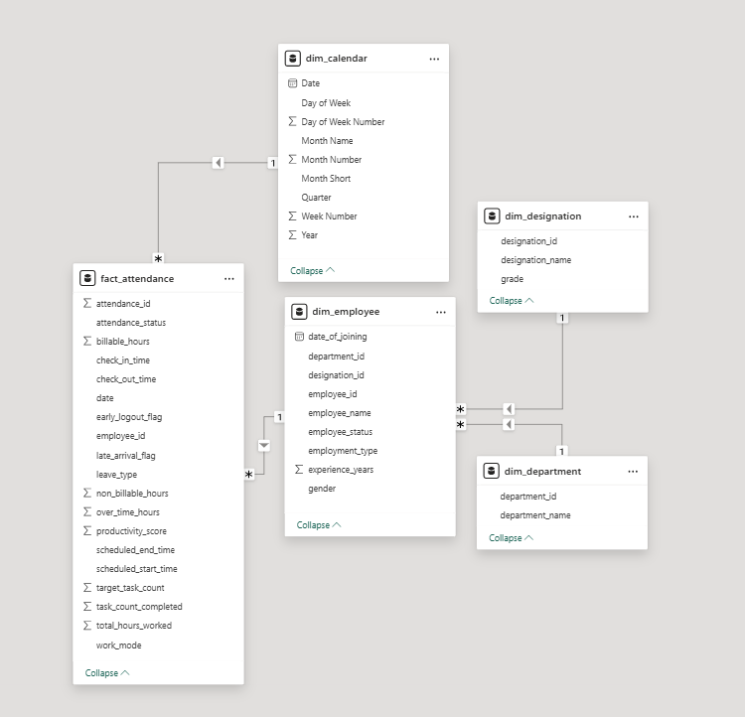
Data Architecture & Semantic Model
Architectural Foundation
Structured 104,000+ granular records into the highly optimized Star Schema pictured left.
Harmonized siloed datasets (Employee Profiles, Designations, Departments, and daily Attendance logs) to enable instantaneous cross-filtering.
The Analytical Engine & Governance
Engineered the proprietary WPI (Weighted Productivity Index) calculation directly into the DAX model logic.
Deployed advanced Time-Intelligence measures, enabling seamless executive drill-downs from yearly macro-trends to daily micro-anomalies.

Slide 6
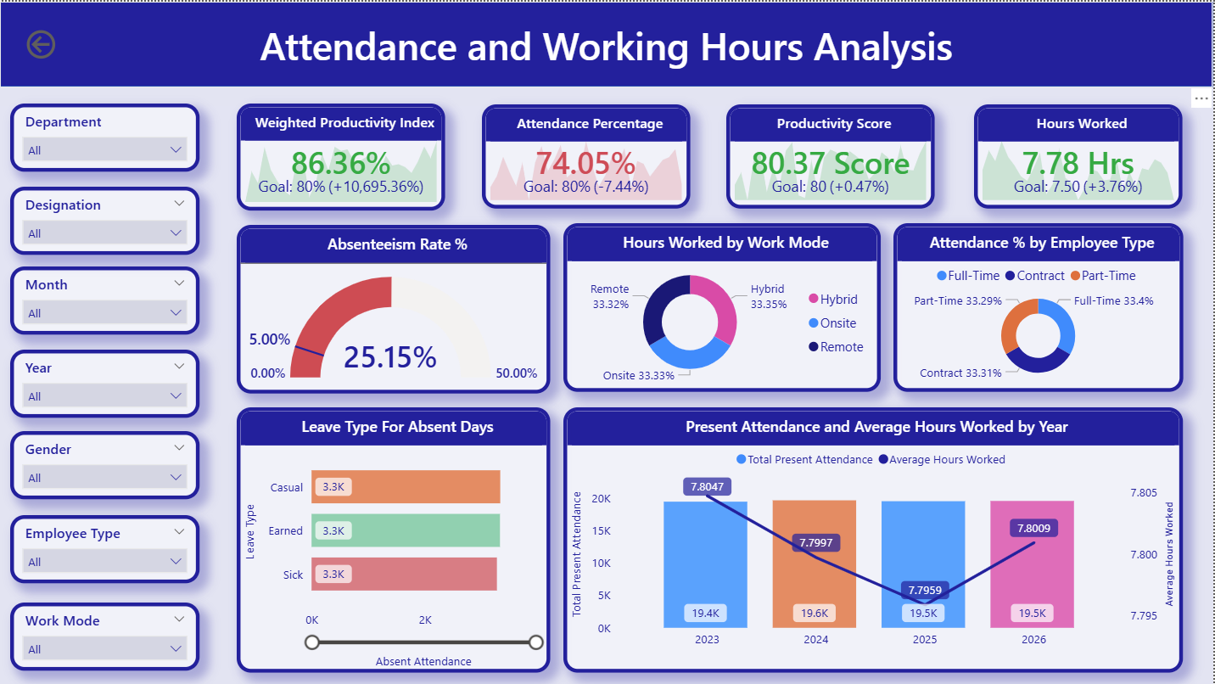
Dashboard Walkthrough & Key Insights
Critical Dashboard Insights:-
Page - 1: Attendance and Working Hours Analysis
The Absenteeism Crisis: The organization is operating at an unsustainable 25.15% absenteeism rate. This is a severe risk to project delivery timelines.
Consistent Underutilization: Despite high productivity scores (79.98), the Average Hours Worked has flatlined at 7.80 hours from 2023 to 2026, consistently tracking below a standard 8-hour shift capacity.
Contractor Dependency: Workforce composition is heavily skewed. Contract employees drive the vast majority of organizational attendance (41.98%), significantly outpacing Full-Time (28.06%) and Part-Time staff.
Uniform Leave Distribution: The 19,700 total absent days are split almost identically across Casual (6.6K), Earned (6.6K), and Sick (6.5K) categories, suggesting employees are utilizing all available leave types indiscriminately.
Perfectly Balanced Work Modes: Hours worked are distributed in a near-perfect three-way split between Remote (33.32%), Hybrid (33.35%), and Onsite (33.33%) environments, indicating no dominant operational modality.

Slide 7
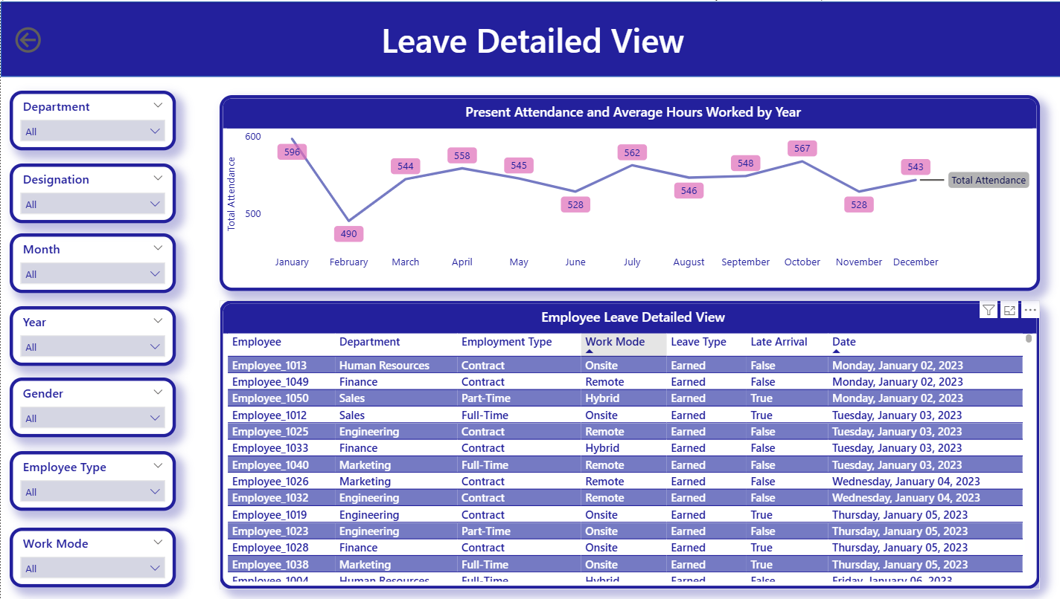
Dashboard Walkthrough & Key Insights
Critical Dashboard Insights:-
Page - 2: Leave Detailed View
Distinct Seasonality: The monthly trend analysis reveals heavy fluctuations in absenteeism. Casual leaves peak sharply during the mid-year months (May and August), creating high-risk periods for project delivery.
End-of-Year Stabilization: Conversely, absenteeism drops to its lowest points in November and December, indicating a period of high resource stability.
Granular Accountability: The detailed matrix maps absences down to the individual Employee ID, Date, and Work Mode. This allows HR to transition from observing high-level departmental trends to initiating highly targeted, data-backed 1-on-1 manager reviews.
Cross-Referencing Lateness: The inclusion of the Late Arrival Flag within the absence detail allows management to detect behavioral patterns, identifying if chronic lateness is a precursor to sudden leave usage.

Slide 8
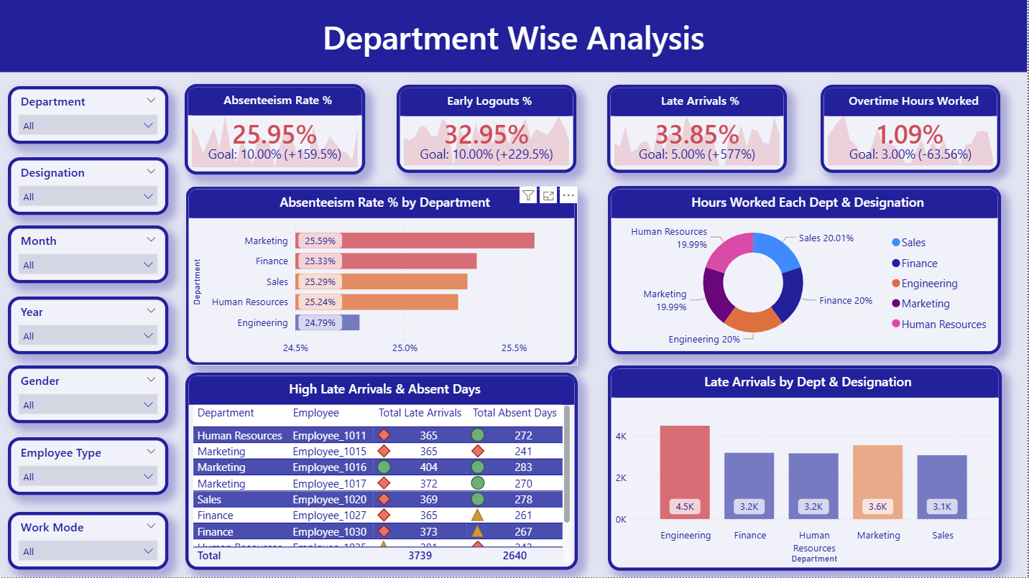
Dashboard Walkthrough & Key Insights
Critical Dashboard Insights:-
Page - 3: Department Wise Analysis
Engineering Punctuality Deficit: The Engineering department drives the highest volume of tardiness with 4,500 Late Arrivals, significantly outpacing Sales (3.1K). This signals a potential structural issue with shift start times for technical teams.
Marketing Absenteeism: The Marketing department holds the highest overall Absenteeism Rate at 25.59%, though all departments are tracking uncomfortably close to the 25% mark, showing widespread absence behavior.
Massive Early Logout Volume: Across the board, Total Early Logouts (35.20K) slightly exceed Total Late Arrivals (35.05K), indicating a systemic culture of abandoning shifts prior to the scheduled end time.
Severe Individual Outliers: The High Late Arrivals matrix exposes critical anomalies masked by department averages. For example, a single employee in Marketing (Employee_1016) has logged an extreme 404 late arrivals and 283 absent days, demanding immediate, targeted HR intervention.

Slide 9
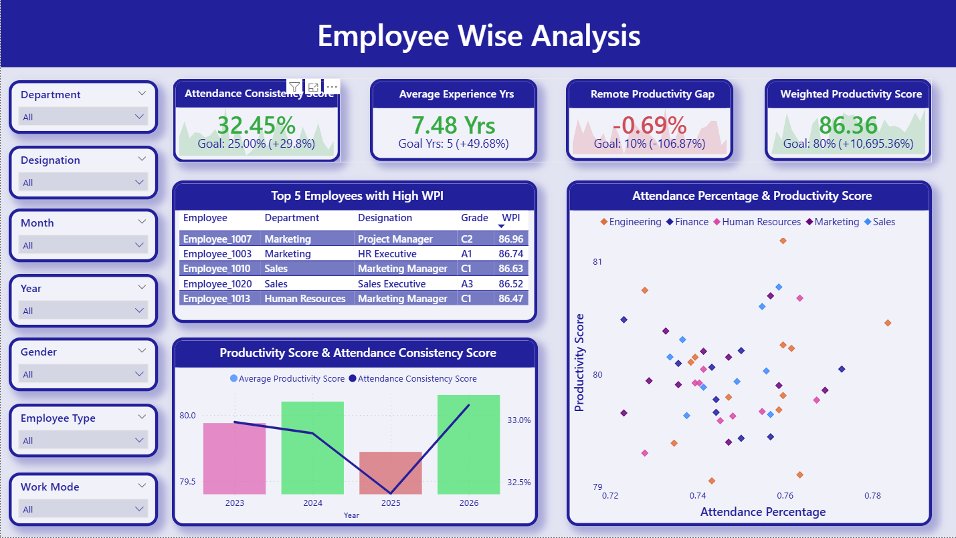
Dashboard Walkthrough & Key Insights
Critical Dashboard Insights:-
Page - 4: Employee Wise Analysis
Top Talent Concentration: The Top 5 Employees by Weighted Productivity Index (WPI) are heavily concentrated in Marketing and Sales, with a Marketing Project Manager (Employee_1007) leading the organization at an 86.08 WPI.
The Presence vs. Output Paradox: The scatter plot definitively proves that high attendance does not equal high output. Several employees with lower attendance percentages (~74%) are achieving top-tier productivity scores (>80), validating the need to measure task completion over mere presence.
The Remote Productivity Gap: The individual metrics reveal a structural -0.12% Remote Productivity Gap. This confirms that while remote work is widely utilized, individual task efficiency drops significantly when employees are off-site.
Historical Resilience: The trend analysis indicates a sharp drop in Attendance Consistency during 2025; however, the Average Productivity Score remained completely stable during that same period, showcasing strong workforce resilience

Slide 10
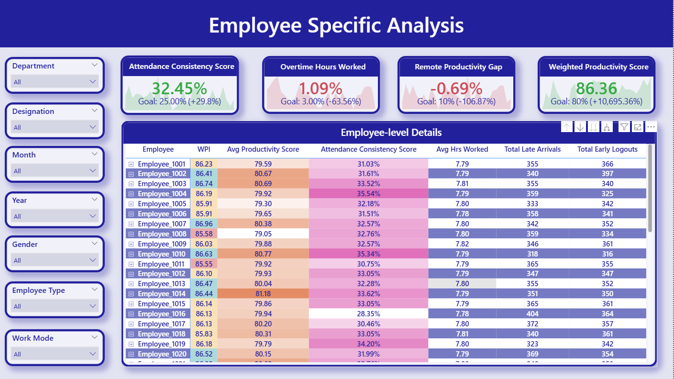
Dashboard Walkthrough & Key Insights
Critical Dashboard Insights:-
Page - 5: Employee Specific Analysis
The Consistency Disconnect: While the overall Weighted Productivity Index (WPI) remains strong at 86.08%, the Attendance Consistency Score is critically low at 32.85%. This proves employees are delivering results through sporadic bursts of high productivity rather than a stable, daily operational rhythm.
Isolating Chronic Offenders: The matrix instantly flags extreme behavioral outliers that require immediate HR action. For example, Employee_1016 presents a severe risk profile with a highly degraded consistency score (28.35%) coupled with a staggering 404 Late Arrivals.
The Workload Ceiling: Across the board, individual average hours are tightly capped at 7.79 to 7.81 hours. This rigid ceiling indicates that employees are strictly adhering to shift boundaries, prioritizing clock-out times over pending task completion.

